Slide 1
Foreign Hotel Advertising
Mikaela Stewart

Slide 2
https://www.youtube.com/watch?v=oiiqgtq18uI Sandals

Slide 3
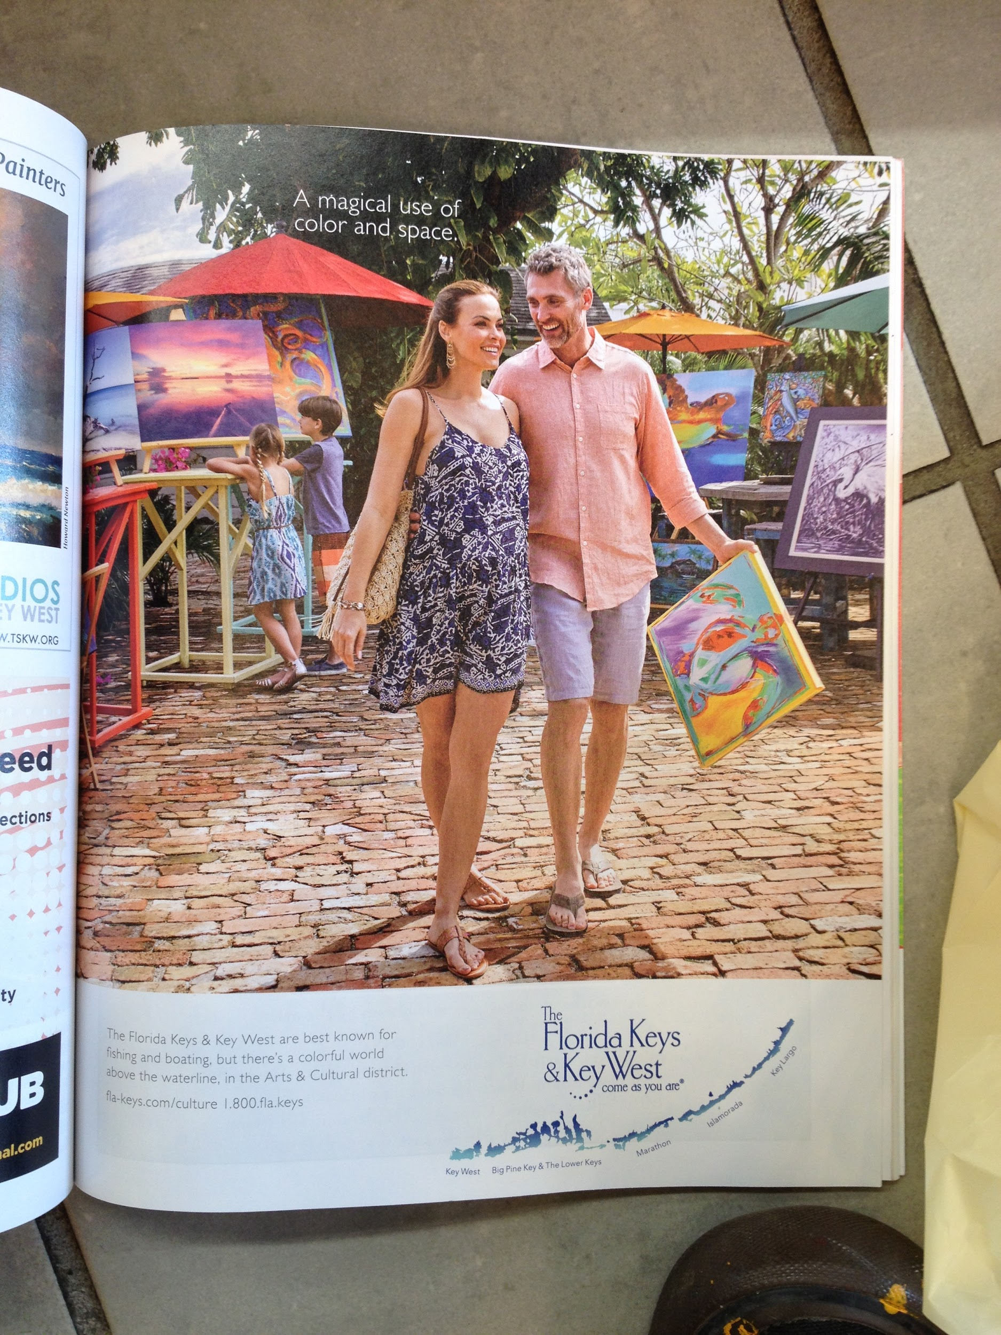

Slide 4
The Gaze and the Other
Derrida’s theory of marked and unmarked, using binary oppositions as a way of distinguishing what is considered to be the norm and what is considered as “other.”

Slide 5
https://www.youtube.com/watch?v=jF-ese8IG44 Beaches

Slide 6
The ads attach notions of exoticism through their imagery.
These images are coded as distant and outside the viewer or consumer’s world of consumption.
The consumer is interpellated as being capable of obtaining this kind of exotic experience.

